Slide 1
COD Ch. 6 Enhancing Performance with Pipelining

Slide 2
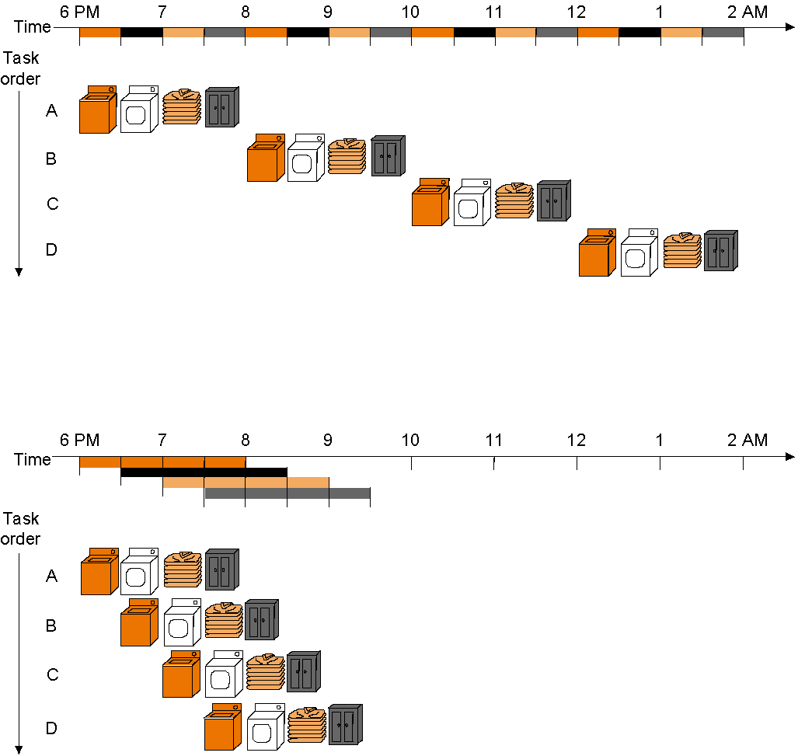
Pipelining
Start work ASAP!! Do not waste time!
Not pipelined
Assume 30 min. each task – wash, dry, fold, store – and that
separate tasks use separate hardware and so can be overlapped
Pipelined

Slide 3
Pipelined vs. Single-Cycle Instruction Execution: the Plan
P
r
o
g
r
a
m
2
4
6
8
1
0
1
2
1
4
1
6
1
8
e
x
e
c
u
t
i
o
n
T
i
m
e
o
r
d
e
r
Single-cycle
(
i
n
i
n
s
t
r
u
c
t
i
o
n
s
)
l
w
$
1
,
1
0
0
(
$
0
)
I
n
s
t
r
u
c
t
i
o
n
R
e
g
A
L
U
D
a
t
a
R
e
g
f
e
t
c
h
a
c
c
e
s
s
l
w
$
2
,
2
0
0
(
$
0
)
8
n
s
I
n
s
t
r
u
c
t
i
o
n
R
e
g
A
L
U
D
a
t
a
R
e
g
f
e
t
c
h
a
c
c
e
s
s
l
w
$
3
,
3
0
0
(
$
0
)
8
n
s
I
n
s
t
r
u
c
t
i
o
n
f
e
t
c
h
.
.
.
8
n
s
Assume 2 ns for memory access, ALU operation; 1 ns for register access:
therefore, single cycle clock 8 ns; pipelined clock cycle 2 ns.
P
r
o
g
r
a
m
2
4
6
8
1
0
1
2
1
4
e
x
e
c
u
t
i
o
n
T
i
m
e
o
r
d
e
r
(
i
n
i
n
s
t
r
u
c
t
i
o
n
s
)
I
n
s
t
r
u
c
t
i
o
n
D
a
t
a
l
w
$
1
,
1
0
0
(
$
0
)
f
e
t
c
h
R
e
g
A
L
U
a
c
c
e
s
s
R
e
g
Pipelined
l
w
$
2
,
2
0
0
(
$
0
)
2
n
s
I
n
s
t
r
u
c
t
i
o
n
R
e
g
A
L
U
D
a
t
a
R
e
g
f
e
t
c
h
a
c
c
e
s
s
I
n
s
t
r
u
c
t
i
o
n
D
a
t
l
w
$
3
,
3
0
0
(
$
0
)
2
n
s
R
a
e
g
A
f
L
U
R
e
g
e
t
c
h
a
c
c
e
s
s
2
n
s
2
n
s
2
n
s
2
n
s
2
n
s
Notes:
‹#›

Slide 4
Pipelining: Keep in Mind
Pipelining does not reduce latency of a single task, it increases throughput of entire workload
Pipeline rate limited by longest stage
potential speedup = number pipe stages
unbalanced lengths of pipe stages reduces speedup
Time to fill pipeline and time to drain it – when there is slack in the pipeline – reduces speedup

Slide 5
Example Problem
Problem: for the laundry fill in the following table when
the stage lengths are 30, 30, 30 30 min., resp.
the stage lengths are 20, 20, 60, 20 min., resp.
Come up with a formula for pipeline speed-up!
Person Unpipelined Pipeline 1 Ratio unpipelined Pipeline 2 Ratio unpiplelined
finish time finish time to pipeline 1 finish time to pipeline 2
1
2
3
4
n

Slide 6
Pipelining MIPS
What makes it easy with MIPS?
all instructions are same length
so fetch and decode stages are similar for all instructions
just a few instruction formats
simplifies instruction decode and makes it possible in one stage
memory operands appear only in load/stores
so memory access can be deferred to exactly one later stage
operands are aligned in memory
one data transfer instruction requires one memory access stage
Notes:
‹#›

Slide 7
Pipelining MIPS
What makes it hard?
structural hazards: different instructions, at different stages, in the pipeline want to use the same hardware resource
control hazards: succeeding instruction, to put into pipeline, depends on the outcome of a previous branch instruction, already in pipeline
data hazards: an instruction in the pipeline requires data to be computed by a previous instruction still in the pipeline
Before actually building the pipelined datapath and control we first briefly examine these potential hazards individually…

Slide 8
Structural Hazards
Structural hazard: inadequate hardware to simultaneously support all instructions in the pipeline in the same clock cycle
E.g., suppose single – not separate – instruction and data memory in pipeline below with one read port
then a structural hazard between first and fourth lw instructions
MIPS was designed to be pipelined: structural hazards are easy to avoid!
P
r
o
g
r
a
m
2
4
6
8
1
0
1
2
1
4
e
x
e
c
u
t
i
o
n
T
i
m
e
o
r
d
e
r
(
i
n
i
n
s
t
r
u
c
t
i
o
n
s
)
I
n
s
t
r
u
c
t
i
o
n
D
a
t
a
l
w
$
1
,
1
0
0
(
$
0
)
f
e
t
c
h
R
e
g
A
L
U
a
c
c
e
s
s
R
e
g
Pipelined
l
w
$
2
,
2
0
0
(
$
0
)
2
n
s
I
n
s
t
r
u
c
t
i
o
n
R
e
g
A
L
U
D
a
t
a
R
e
g
f
e
t
c
h
a
c
c
e
s
s
Hazard if single memory
l
w
$
3
,
3
0
0
(
$
0
)
2
n
s
I
n
s
t
r
u
c
t
i
o
n
R
e
g
A
L
U
D
a
t
a
R
e
g
f
e
t
c
h
a
c
c
e
s
s
l
w
$
4
,
4
0
0
(
$
0
)
I
n
s
t
r
u
c
t
i
o
n
R
e
g
A
L
U
D
a
t
a
R
e
g
2
n
s
f
e
t
c
h
a
c
c
e
s
s
2
n
s
2
n
s
2
n
s
2
n
s
2
n
s

Slide 9
Control Hazards
Control hazard: need to make a decision based on the result of a previous instruction still executing in pipeline
Solution 1 Stall the pipeline
P
r
o
g
r
a
m
e
x
e
c
u
t
i
o
n
2
4
6
8
1
0
1
2
1
4
1
6
o
T
i
m
e
r
d
e
r
(
i
n
i
n
s
t
r
u
c
t
i
o
n
s
)
I
n
s
t
r
u
c
t
i
o
n
R
e
g
A
L
U
D
a
t
a
R
e
g
Note that branch outcome is
computed in ID stage with
added hardware (later…)
a
d
d
$
4
,
$
5
,
$
6
f
e
t
c
h
a
c
c
e
s
s
b
e
q
$
1
,
$
2
,
4
0
I
n
s
t
r
u
c
t
i
o
n
R
e
g
A
L
U
D
a
t
a
R
e
g
2
n
s
f
e
t
c
h
a
c
c
e
s
s
l
w
$
3
,
3
0
0
(
$
0
)
b
u
b
b
l
e
I
n
s
t
r
u
c
t
i
o
n
R
e
g
A
L
U
D
a
t
a
R
e
g
f
e
t
c
h
a
c
c
e
s
s
4
n
s
2
n
s
Pipeline stall

Slide 10
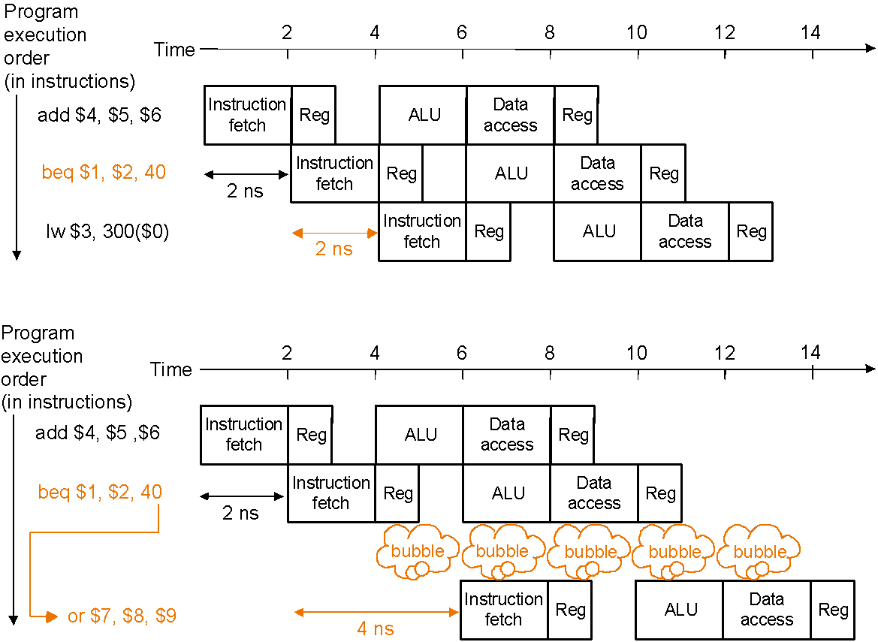
Control Hazards
Solution 2 Predict branch outcome
e.g., predict branch-not-taken :
Prediction success
Prediction failure: undo (=flush) lw

Slide 11
Control Hazards
Solution 3 Delayed branch: always execute the sequentially next statement with the branch executing after one instruction delay – compiler’s job to find a statement that can be put in the slot that is independent of branch outcome
MIPS does this – but it is an option in SPIM (Simulator -> Settings)
P
r
o
g
r
a
m
e
x
e
c
u
t
i
o
n
2
4
6
8
1
0
1
2
1
4
o
r
d
e
r
T
i
m
e
(
i
n
i
n
s
t
r
u
c
t
i
o
n
s
)
b
e
q
$
1
,
$
2
,
4
0
I
n
s
t
r
u
c
t
i
o
n
R
e
g
A
L
U
D
a
t
a
R
e
g
f
e
t
c
h
a
c
c
e
s
s
a
d
d
$
4
,
$
5
,
$
6
I
n
s
t
r
u
c
t
i
o
n
R
e
g
A
L
U
D
a
t
a
R
e
g
(
2
n
s
f
e
t
c
h
a
c
c
e
s
s
d
e
l
a
y
e
d
b
r
a
n
c
h
s
l
o
t
)
l
w
$
3
,
3
0
0
(
$
0
)
I
n
s
t
r
u
c
t
i
o
n
R
e
g
A
L
U
D
a
t
a
R
e
g
2
n
s
f
e
t
c
h
a
c
c
e
s
s
2
n
s
Delayed branch beq is followed by add that is
independent of branch outcome

Slide 12
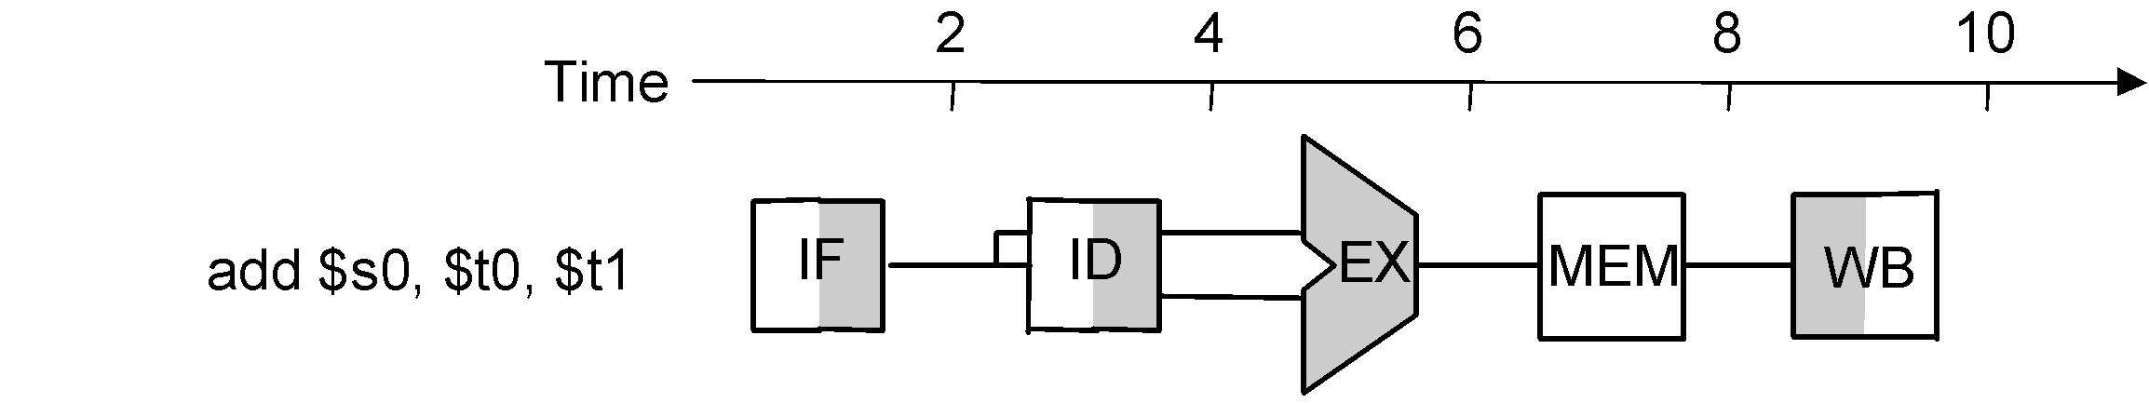
Data Hazards
Data hazard: instruction needs data from the result of a previous instruction still executing in pipeline
Solution Forward data if possible…
Instruction pipeline diagram:
shade indicates use –
left=write, right=read
P
r
o
g
r
e
x
e
c
a
m
u
t
i
o
o
n
2
4
6
8
1
0
r
d
e
r
T
i
(
m
e
i
n
i
n
s
t
r
u
c
t
i
o
n
s
)
Without forwarding – blue line –
data has to go back in time;
with forwarding – red line –
data is available in time
a
d
d
$
s
0
,
$
t
0
,
$
t
1
I
F
I
D
E
X
M
E
M
W
B
s
u
b
$
t
2
,
$
s
0
,
$
t
3
I
M
E
M
F
I
D
E
X
M
E
M
W
B

Slide 13
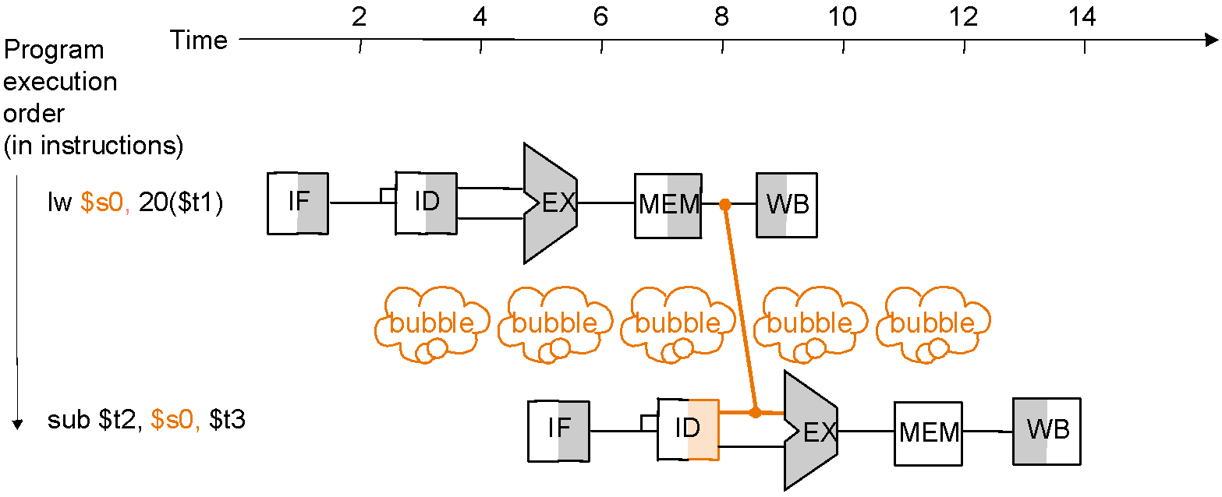
Data Hazards
Forwarding may not be enough
e.g., if an R-type instruction following a load uses the result of the load – called load-use data hazard
T
i
m
e
2
4
6
8
1
0
1
2
1
4
P
r
o
g
r
a
m
e
x
e
c
u
t
i
o
n
o
r
d
e
r
(
i
n
i
n
s
t
r
u
c
t
i
o
n
s
)
Without a stall it is impossible
to provide input to the sub
instruction in time
l
w
$
s
0
,
2
0
(
$
t
1
)
I
F
I
D
E
X
M
E
M
W
B
s
u
b
$
t
2
,
$
s
0
,
$
t
3
I
F
I
D
E
X
M
E
M
W
B
With a one-stage stall, forwarding
can get the data to the sub
instruction in time

Slide 14
Reordering Code to Avoid Pipeline Stall (Software Solution)
Example:
lw $t0, 0($t1)
lw $t2, 4($t1)
sw $t2, 0($t1)
sw $t0, 4($t1)
Reordered code:
lw $t0, 0($t1)
lw $t2, 4($t1)
sw $t0, 4($t1)
sw $t2, 0($t1)
Data hazard
Interchanged

Slide 15
Pipelined Datapath
We now move to actually building a pipelined datapath
First recall the 5 steps in instruction execution
Instruction Fetch & PC Increment (IF)
Instruction Decode and Register Read (ID)
Execution or calculate address (EX)
Memory access (MEM)
Write result into register (WB)
Review: single-cycle processor
all 5 steps done in a single clock cycle
dedicated hardware required for each step
What happens if we break the execution into multiple cycles, but keep the extra hardware?

Slide 16

Review - Single-Cycle Datapath “Steps”
ADD
4
ADD
PC
<<2
ADDR
RD
Instruction
I
Instruction
32
16
32
5
5
5
Memory
RN1
RN2
WN
Register File
RD1
ALU
Zero
WD
RD2
M
U
ADDR
X
Data
E
Memory
RD
M
16
X
32
U
T
WD
X
N
D
IF
Instruction Fetch
ID
Instruction Decode
EX
Execute/ Address Calc.
MEM
Memory Access
WB
Write Back

Slide 17
Pipelined Datapath – Key Idea
What happens if we break the execution into multiple cycles, but keep the extra hardware?
Answer: We may be able to start executing a new instruction at each clock cycle - pipelining
…but we shall need extra registers to hold data between cycles – pipeline registers

Slide 18
Pipelined Datapath
Pipeline registers
wide enough to hold data coming in
ADD
4
64 bits
128 bits
ADD
PC
<<2
97 bits
64 bits
ADDR
RD
Instruction
I
Instruction
32
16
32
5
5
5
Memory
RN1
RN2
WN
RD1
Zero
Register File
ALU
WD
RD2
M
U
ADDR
X
Data
E
Memory
RD
M
16
X
32
U
T
WD
X
N
D
IF/ID
ID/EX
EX/MEM
MEM/WB

Slide 19
Pipelined Datapath
Pipeline registers
wide enough to hold data coming in
ADD
4
64 bits
128 bits
ADD
PC
<<2
97 bits
64 bits
ADDR
RD
Instruction
I
Instruction
32
16
32
5
5
5
Memory
RN1
RN2
WN
RD1
Zero
Register File
ALU
WD
RD2
M
U
ADDR
X
Data
E
Memory
RD
M
16
X
32
U
T
WD
X
N
D
IF/ID
ID/EX
EX/MEM
MEM/WB
Only data flowing right to left may cause hazard…, why?

Slide 20
Bug in the Datapath
IF/ID
ID/EX
EX/MEM
MEM/WB
ADD
4
ADD
PC
<<2
ADDR
RD
Instruction
I
Instruction
32
16
32
5
5
5
Memory
RN1
RN2
WN
Register File
RD1
ALU
WD
RD2
M
U
ADDR
X
Data
E
Memory
RD
M
16
X
32
U
T
WD
X
N
D
Write register number comes from another later instruction!

Slide 21

Corrected Datapath
IF/ID
ID/EX
EX/MEM
MEM/WB
ADD
64 bits
133 bits
ADD
4
102 bits
69 bits
<<2
PC
ADDR
RD
32
5
RN1
RD1
Zero
Instruction
RN2
ALU
Memory
5
Register
5
WN
File
RD2
WD
M
ADDR
U
X
Data
E
Memory
RD
M
16
X
32
U
T
WD
X
N
5
D
Destination register number is also passed through ID/EX, EX/MEM
and MEM/WB registers, which are now wider by 5 bits

Slide 22
Pipelined Example
Consider the following instruction sequence:
lw $t0, 10($t1)
sw $t3, 20($t4)
add $t5, $t6, $t7
sub $t8, $t9, $t10

Slide 23
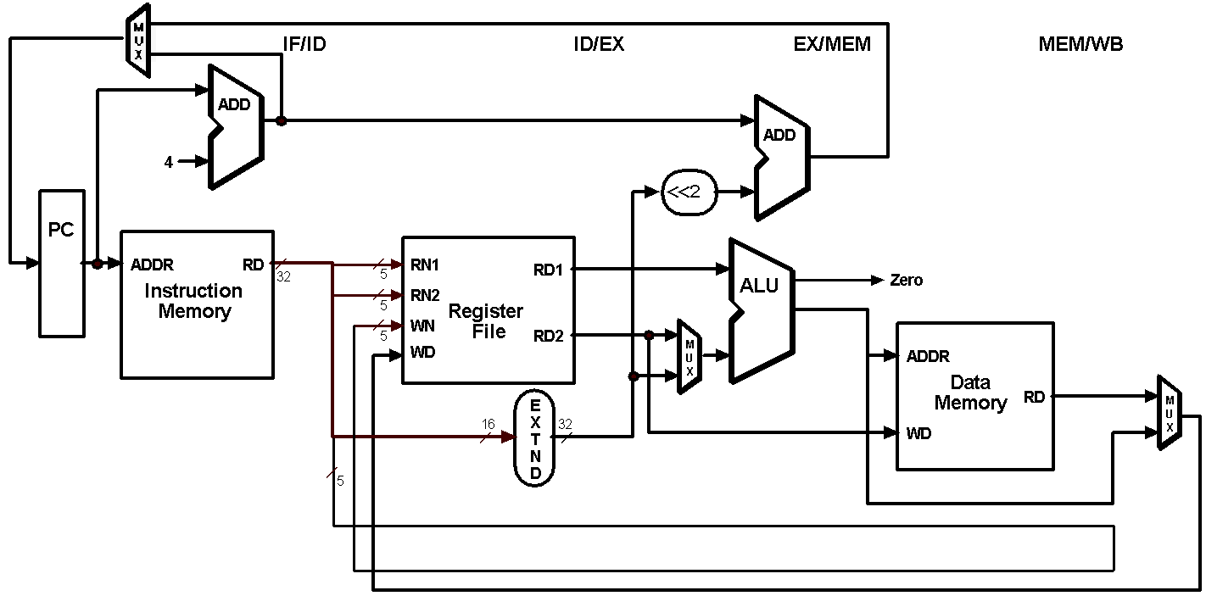
Single-Clock-Cycle Diagram: Clock Cycle 1
LW

Slide 24
Single-Clock-Cycle Diagram: Clock Cycle 2
SW
LW

Slide 25
Single-Clock-Cycle Diagram: Clock Cycle 3
ADD
SW
LW

Slide 26
Single-Clock-Cycle Diagram: Clock Cycle 4
SUB
ADD
SW
LW

Slide 27
Single-Clock-Cycle Diagram: Clock Cycle 5
SUB
ADD
SW
LW

Slide 28
Single-Clock-Cycle Diagram: Clock Cycle 6
SUB
ADD
SW

Slide 29
Single-Clock-Cycle Diagram: Clock Cycle 7
SUB
ADD

Slide 30
Single-Clock-Cycle Diagram: Clock Cycle 8
SUB

Slide 31
Alternative View – Multiple-Clock-Cycle Diagram
CC 1
CC 2
CC 3
CC 4
CC 5
CC 6
CC 7
CC 8
Time axis
lw $t0, 10($t1)
IM
REG
ALU
DM
REG
sw $t3, 20($t4)
IM
REG
ALU
DM
REG
add $t5, $t6, $t7
IM
REG
ALU
DM
REG
sub
$t8, $t9, $t10
IM
REG
ALU
DM
REG

Slide 32
Notes
One significant difference in the execution of an R-type instruction between multicycle and pipelined implementations:
register write-back for the R-type instruction is the 5th (the last write-back) pipeline stage vs. the 4th stage for the multicycle implementation. Why?
think of structural hazards when writing to the register file…
Worth repeating: the essential difference between the pipeline and multicycle implementations is the insertion of pipeline registers to decouple the 5 stages
The CPI of an ideal pipeline (no stalls) is 1. Why?
The RaVi Architecture Visualization Project of Dortmund U. has pipeline simulations – see link in our Additional Resources page
As we develop control for the pipeline keep in mind that the text does not consider jump – should not be too hard to implement!

Slide 33
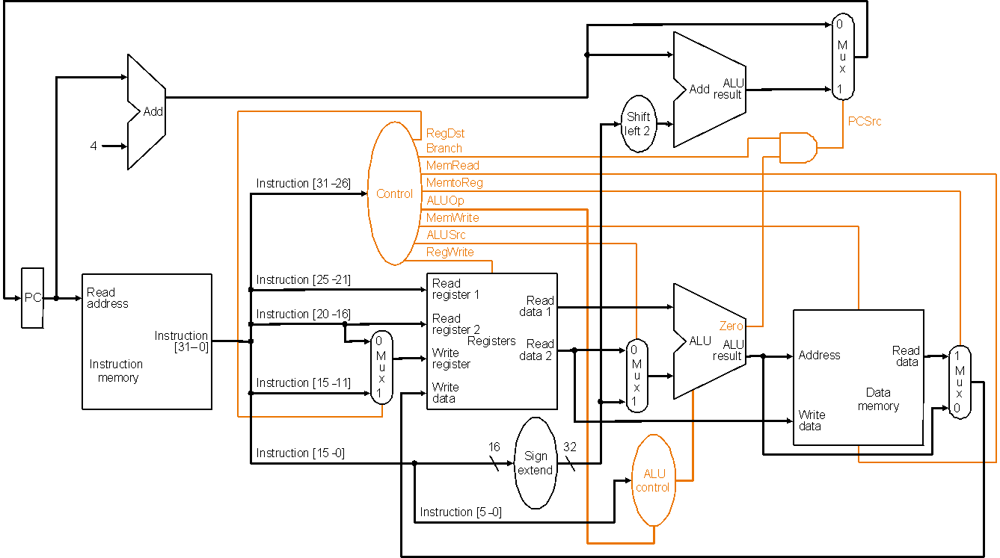
Recall Single-Cycle Control – the Datapath

Slide 34
Recall Single-Cycle – ALU Control
Instruction AluOp Instruction Funct Field Desired ALU control
opcode operation ALU action input
LW 00 load word xxxxxx add 010
SW 00 store word xxxxxx add 010
Branch eq 01 branch eq xxxxxx subtract 110
R-type 10 add 100000 add 010
R-type 10 subtract 100010 subtract 110
R-type 10 AND 100100 and 000
R-type 10 OR 100101 or 001
R-type 10 set on less 101010 set on less 111
ALUOp
Funct field
Operation
ALUOp1
ALUOp0
F5
F4
F3
F2
F1
F0
0
0
X
X
X
X
X
X
010
0
1
X
X
X
X
X
X
110
1
X
X
X
0
0
0
0
010
1
X
X
X
0
0
1
0
110
1
X
X
X
0
1
0
0
000
1
X
X
X
0
1
0
1
001
1
X
X
X
1
0
1
0
111
Truth table for ALU control bits

Slide 35
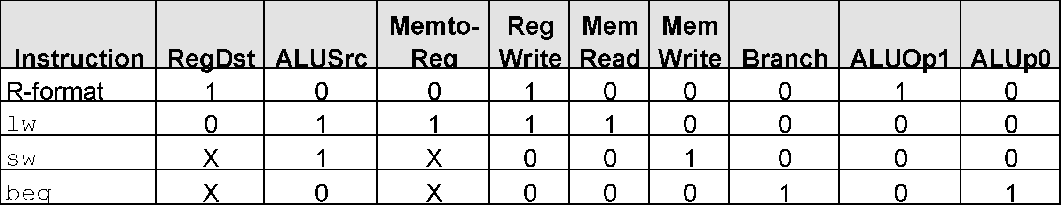
Recall Single-Cycle – Control Signals
Effect of control bits
Signal Name Effect when deasserted Effect when asserted
RegDst The register destination number for the The register destination number for the
Write register comes from the rt field (bits 20-16) Write register comes from the rd field (bits 15-11)
RegWrite None The register on the Write register input is written
with the value on the Write data input
AlLUSrc The second ALU operand comes from the The second ALU operand is the sign-extended,
second register file output (Read data 2) lower 16 bits of the instruction
PCSrc The PC is replaced by the output of the adder The PC is replaced by the output of the adder
that computes the value of PC + 4 that computes the branch target
MemRead None Data memory contents designated by the address
input are put on the first Read data output
MemWrite None Data memory contents designated by the address
input are replaced by the value of the Write data input
MemtoReg The value fed to the register Write data input The value fed to the register Write data input
comes from the ALU comes from the data memory
Deter-
mining
control
bits

Slide 36
Pipeline Control
Initial design – motivated by single-cycle datapath control – use the same control signals
Observe:
No separate write signal for the PC as it is written every cycle
No separate write signals for the pipeline registers as they are written every cycle
No separate read signal for instruction memory as it is read every clock cycle
No separate read signal for register file as it is read every clock cycle
Need to set control signals during each pipeline stage
Since control signals are associated with components active during a single pipeline stage, can group control lines into five groups according to pipeline stage
Will be
modified
by hazard
detection
unit!!

Slide 37
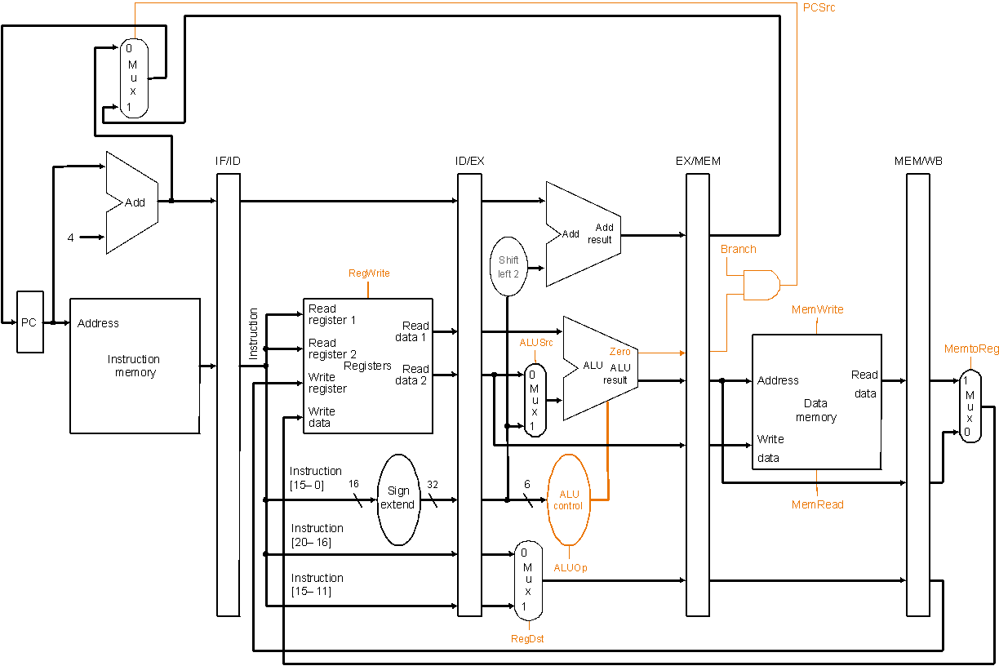
Pipelined Datapath with Control I
Same control
signals as the
single-cycle
datapath
Notes:
‹#›

Slide 38
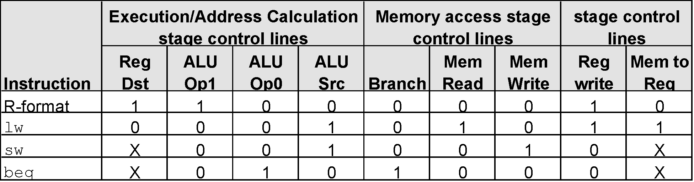
Pipeline Control Signals
There are five stages in the pipeline
instruction fetch / PC increment
instruction decode / register fetch
execution / address calculation
memory access
write back
Nothing to control as instruction memory
read and PC write are always enabled
Notes:
‹#›

Slide 39
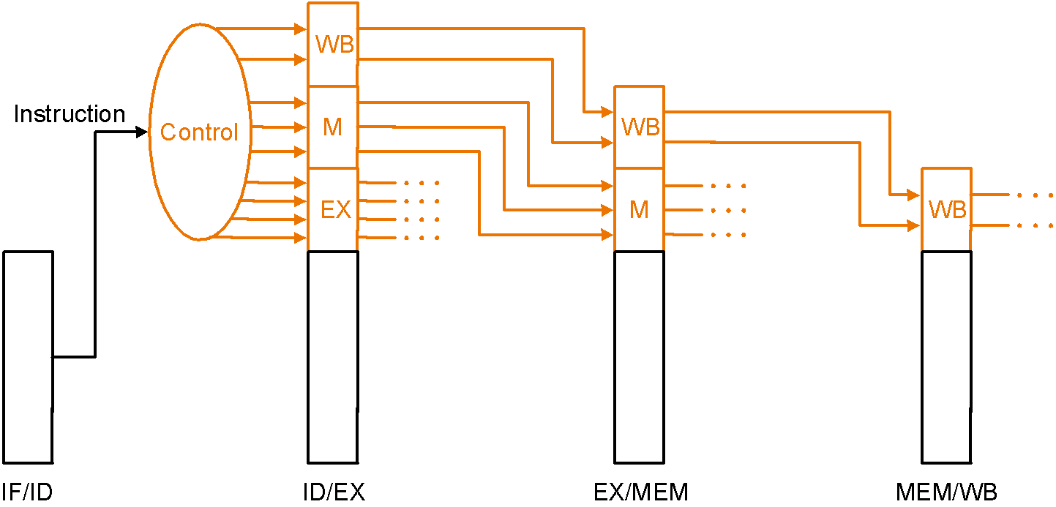
Pipeline Control Implementation
Pass control signals along just like the data – extend each pipeline register to hold needed control bits for succeeding stages
Note: The 6-bit funct field of the instruction required in the EX stage to generate ALU control can be retrieved as the 6 least significant bits of the immediate field which is sign-extended and passed from the IF/ID register to the ID/EX register
Notes:
‹#›

Slide 40
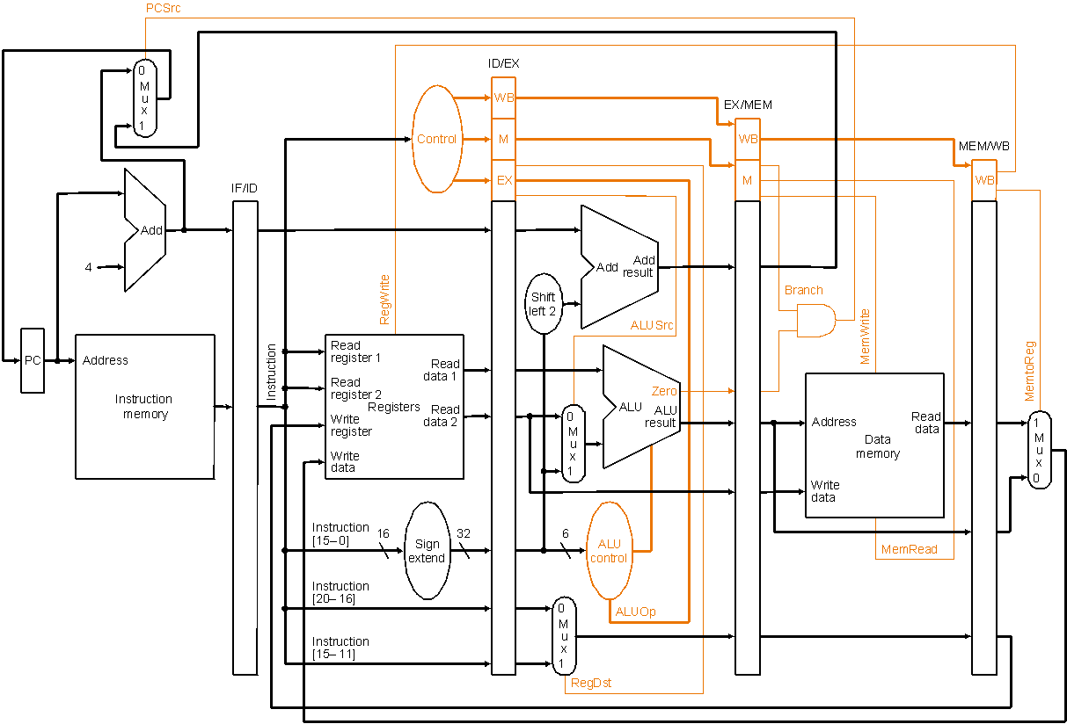
Pipelined Datapath with Control II
Control signals
emanate from
the control
portions of the
pipeline registers
Notes:
‹#›

Slide 41
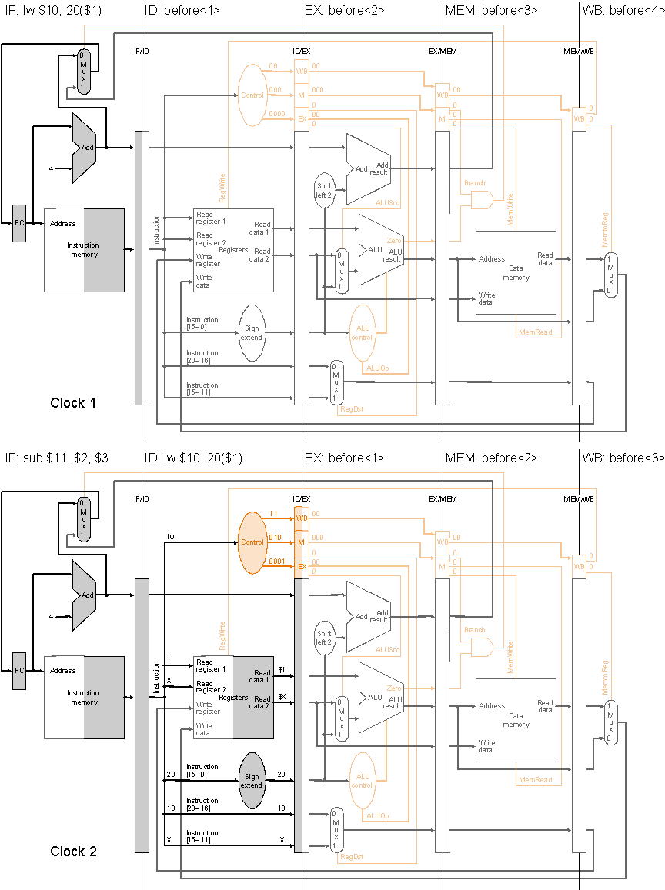
Pipelined Execution and Control
Clock cycle 1
Instruction
sequence:
lw $10, 20($1)
sub $11, $2, $3
and $12, $4, $7
or $13, $6, $7
add $14, $8, $9
Label “before<i>” means
i th instruction before
lw
Clock cycle 2

Slide 42
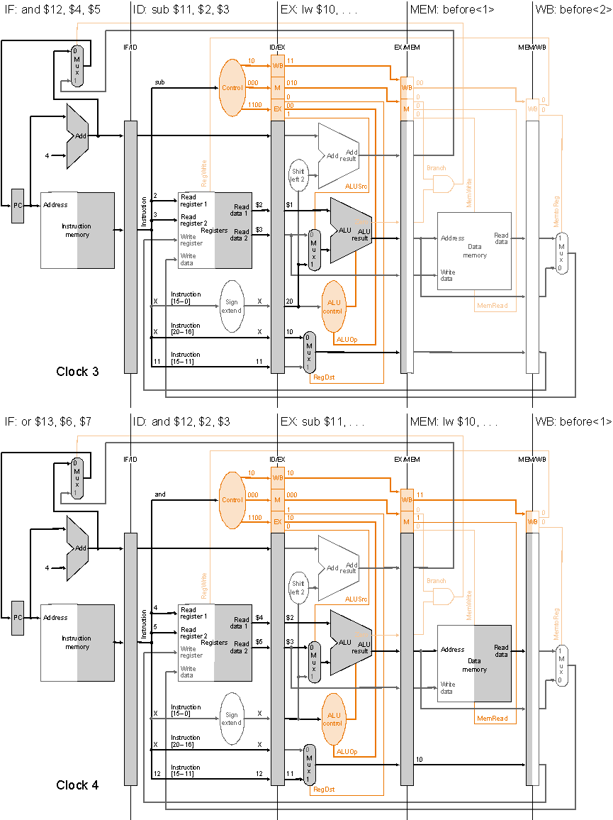
Pipelined Execution and Control
Clock cycle 3
Instruction
sequence:
lw $10, 20($1)
sub $11, $2, $3
and $12, $4, $7
or $13, $6, $7
add $14, $8, $9
Clock cycle 4

Slide 43
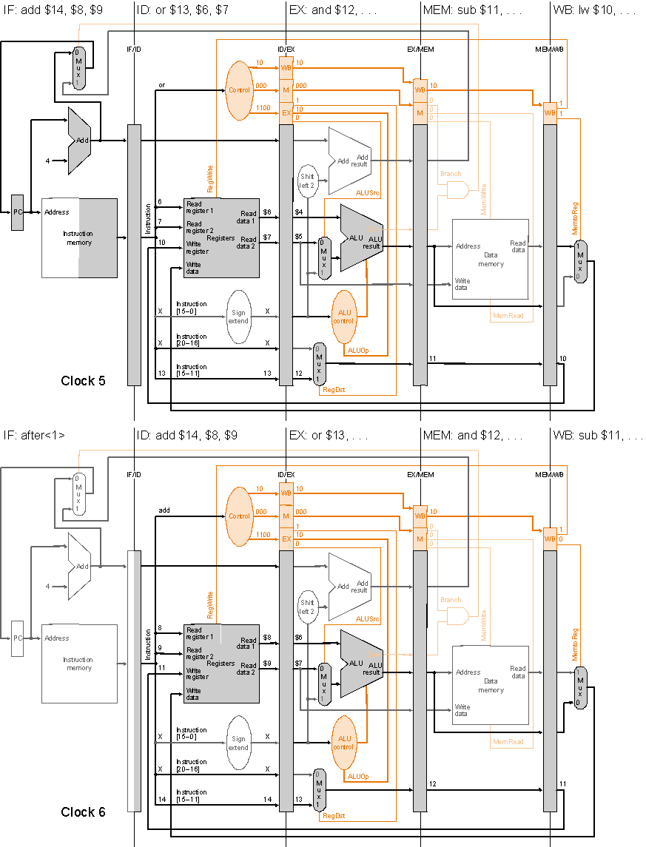
Pipelined Execution and Control
Clock cycle 5
Instruction
sequence:
lw $10, 20($1)
sub $11, $2, $3
and $12, $4, $7
or $13, $6, $7
add $14, $8, $9
Label “after<i>” means
i th instruction after add
Clock cycle 6

Slide 44
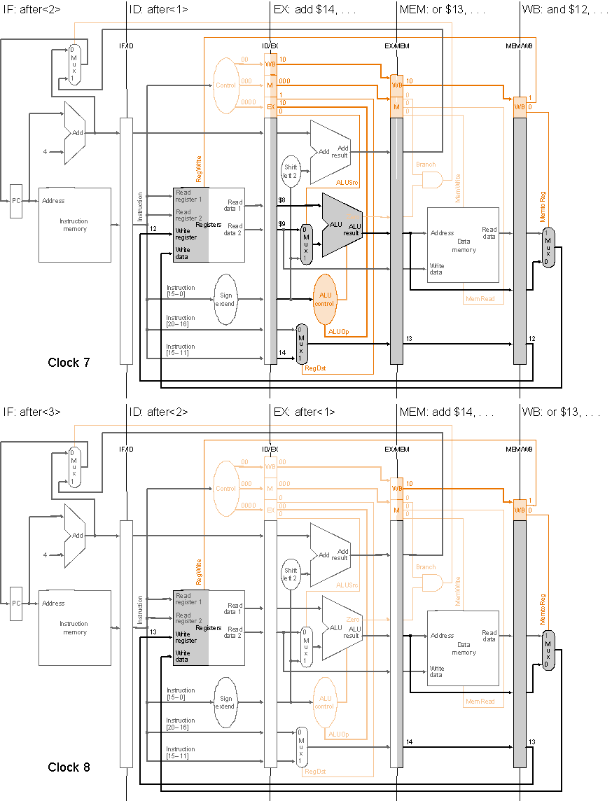
Pipelined Execution and Control
Clock cycle 7
Instruction
sequence:
lw $10, 20($1)
sub $11, $2, $3
and $12, $4, $7
or $13, $6, $7
add $14, $8, $9
Clock cycle 8

Slide 45
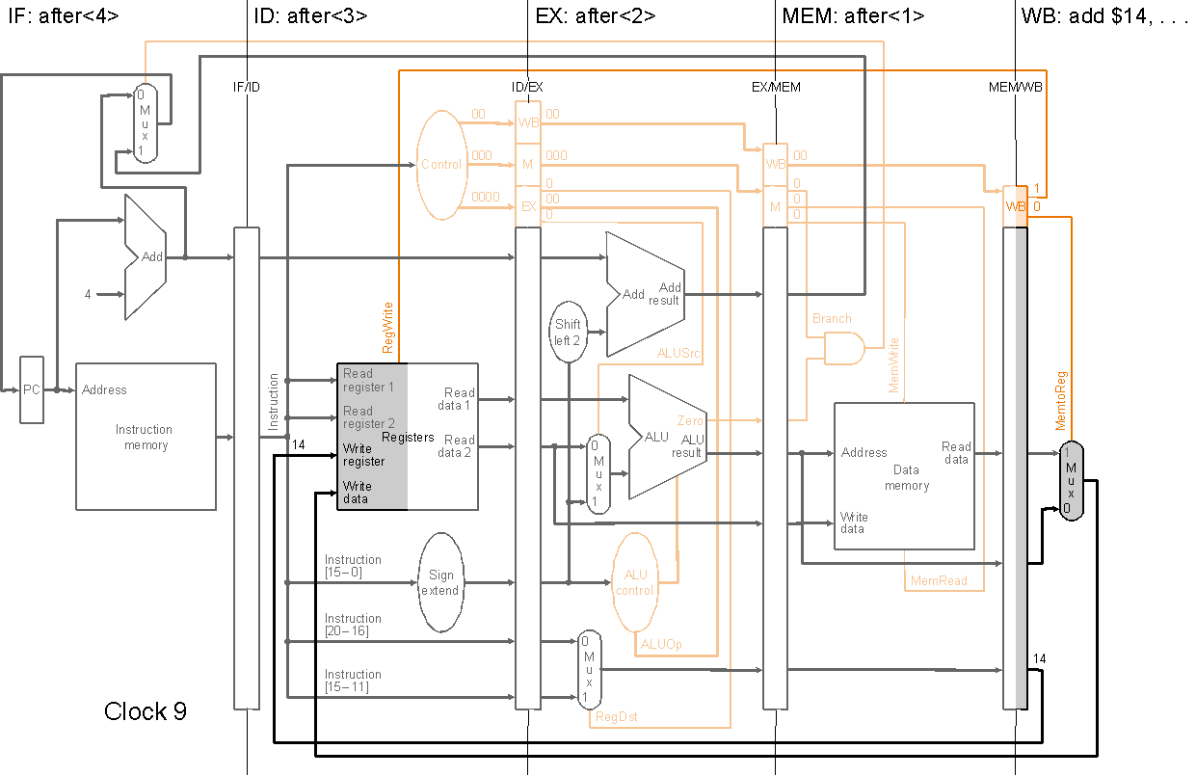
Pipelined Execution and Control
Instruction
sequence:
lw $10, 20($1)
sub $11, $2, $3
and $12, $4, $7
or $13, $6, $7
add $14, $8, $9
Clock cycle 9

Slide 46
Revisiting Hazards
So far our datapath and control have ignored hazards
We shall revisit data hazards and control hazards and enhance our datapath and control to handle them in hardware…

Slide 47
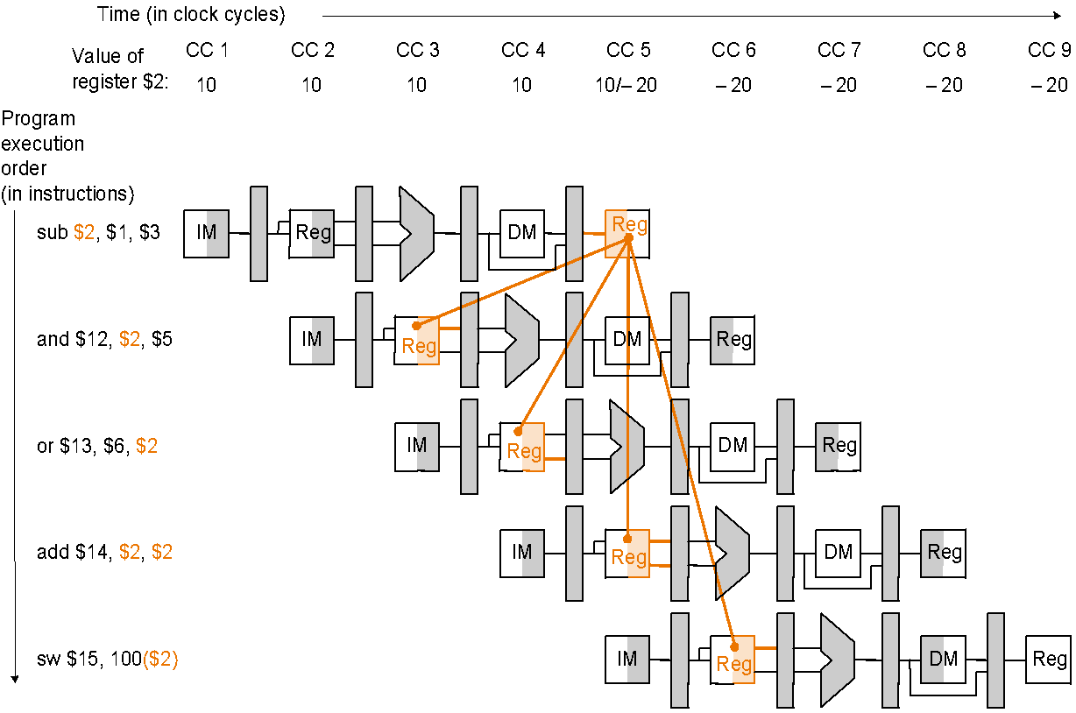
Data Hazards and Forwarding
Problem with starting an instruction before previous are finished:
data dependencies that go backward in time – called data hazards
$2 = 10 before sub;
$2 = -20 after sub
sub $2, $1, $3
and $12, $2, $5
or $13, $6, $2
add $14, $2, $2
sw $15, 100($2)
Notes:
‹#›

Slide 48
Software Solution
Have compiler guarantee never any data hazards!
by rearranging instructions to insert independent instructions between instructions that would otherwise have a data hazard between them,
or, if such rearrangement is not possible, insert nops
Such compiler solutions may not always be possible, and nops slow the machine down
sub $2, $1, $3
lw $10, 40($3)
slt $5, $6, $7 and $12, $2, $5 or $13, $6, $2 add $14, $2, $2 sw $15, 100($2)
sub $2, $1, $3
nop
nop and $12, $2, $5 or $13, $6, $2 add $14, $2, $2 sw $15, 100($2)
or
MIPS: nop = “no operation” = 00…0 (32bits) = sll $0, $0, 0
Notes:
‹#›

Slide 49
Hardware Solution: Forwarding
Idea: use intermediate data, do not wait for result to be finally written to the destination register. Two steps:
Detect data hazard
Forward intermediate data to resolve hazard

Slide 50
Pipelined Datapath with Control II (as before)
Control signals
emanate from
the control
portions of the
pipeline registers
Notes:
‹#›

Slide 51
Hazard Detection
Hazard conditions:
1a. EX/MEM.RegisterRd = ID/EX.RegisterRs
1b. EX/MEM.RegisterRd = ID/EX.RegisterRt
2a. MEM/WB.RegisterRd = ID/EX.RegisterRs
2b. MEM/WB.RegisterRd = ID/EX.RegisterRt
Eg., in the earlier example, first hazard between sub $2, $1, $3 and
and $12, $2, $5 is detected when the and is in EX stage and the
sub is in MEM stage because
EX/MEM.RegisterRd = ID/EX.RegisterRs = $2 (1a)
Whether to forward also depends on:
if the later instruction is going to write a register – if not, no need to forward, even if there is register number match as in conditions above
if the destination register of the later instruction is $0 – in which case
there is no need to forward value ($0 is always 0 and never overwritten)

Slide 52
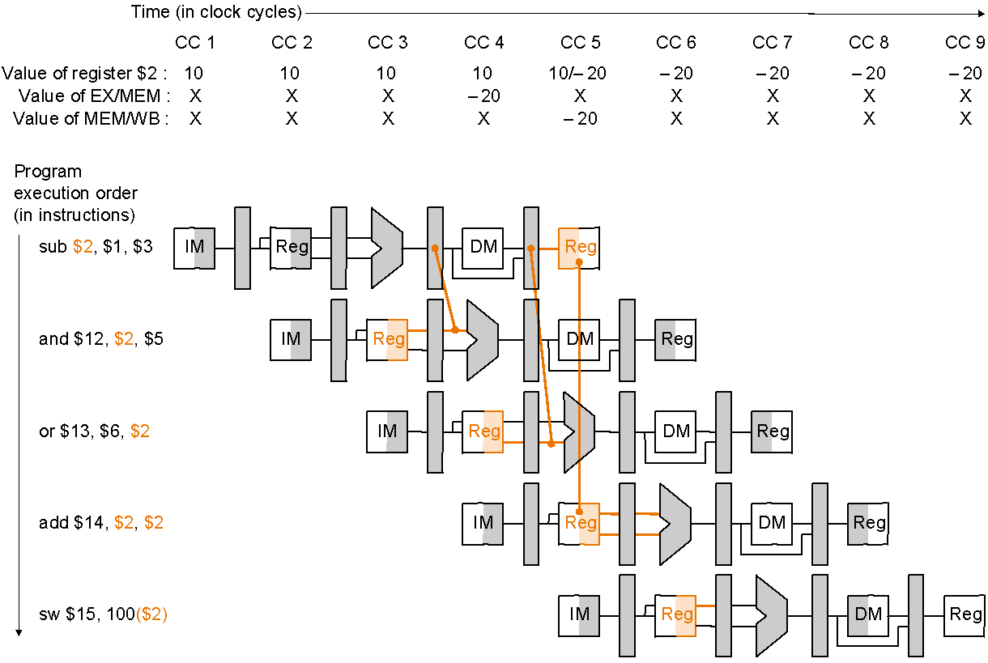
Data Forwarding
Plan:
allow inputs to the ALU not just from ID/EX, but also later pipeline registers, and
use multiplexors and control signals to choose appropriate inputs to ALU
sub $2, $1, $3
and $12, $2, $5
or $13, $6, $2
add $14, $2, $2
sw $15, 100($2)
Dependencies between pipelines move forward in time

Slide 53
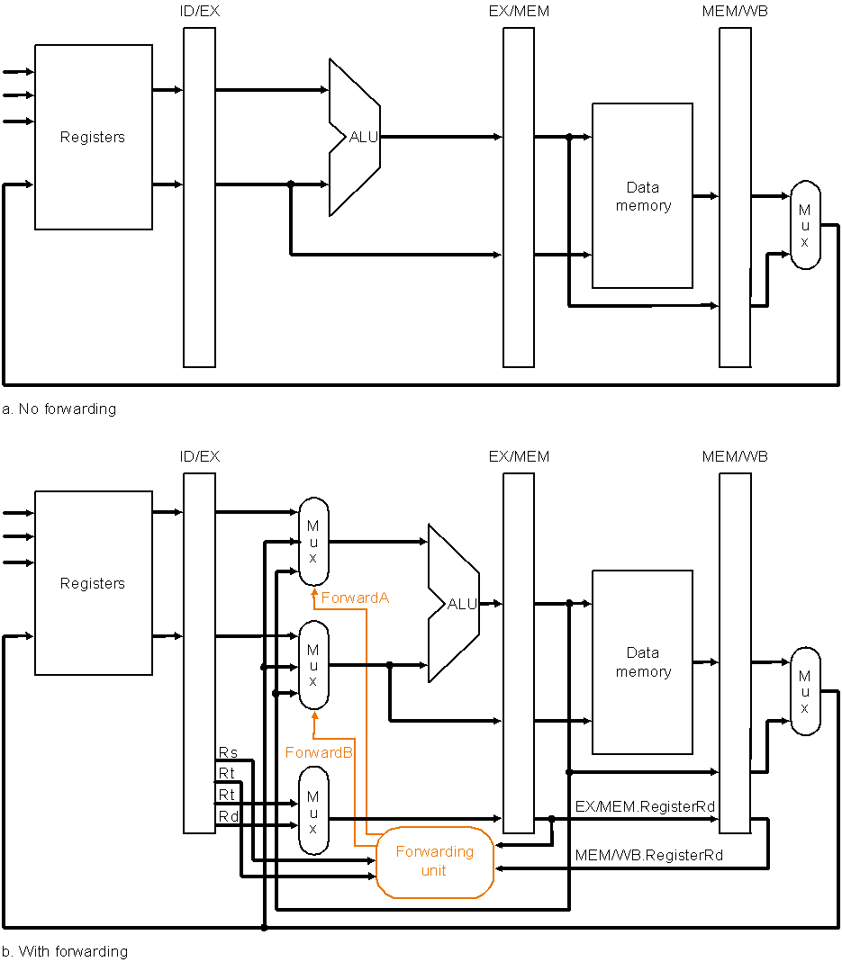
Forwarding Hardware
Datapath before adding forwarding hardware
Datapath after adding forwarding hardware

Slide 54
Forwarding Hardware: Multiplexor Control
Mux control Source Explanation
ForwardA = 00 ID/EX The first ALU operand comes from the register file
ForwardA = 10 EX/MEM The first ALU operand is forwarded from prior ALU result
ForwardA = 01 MEM/WB The first ALU operand is forwarded from data memory
or an earlier ALU result
ForwardB = 00 ID/EX The second ALU operand comes from the register file
ForwardB = 10 EX/MEM The second ALU operand is forwarded from prior ALU result
ForwardB = 01 MEM/WB The second ALU operand is forwarded from data memory
or an earlier ALU result
Depending on the selection in the rightmost multiplexor
(see datapath with control diagram)

Slide 55
Data Hazard: Detection and Forwarding
Forwarding unit determines multiplexor control according to the following rules:
EX hazard
if ( EX/MEM.RegWrite // if there is a write…
and ( EX/MEM.RegisterRd ≠ 0 ) // to a non-$0 register…
and ( EX/MEM.RegisterRd = ID/EX.RegisterRs ) ) // which matches, then… ForwardA = 10
if ( EX/MEM.RegWrite // if there is a write…
and ( EX/MEM.RegisterRd ≠ 0 ) // to a non-$0 register…
and ( EX/MEM.RegisterRd = ID/EX.RegisterRt ) ) // which matches, then… ForwardB = 10

Slide 56
Data Hazard: Detection and Forwarding
MEM hazard
if ( MEM/WB.RegWrite // if there is a write…
and ( MEM/WB.RegisterRd ≠ 0 ) // to a non-$0 register…
and ( EX/MEM.RegisterRd ≠ ID/EX.RegisterRs ) // and not already a register match
// with earlier pipeline register…
and ( MEM/WB.RegisterRd = ID/EX.RegisterRs ) ) // but match with later pipeline
register, then…
ForwardA = 01
if ( MEM/WB.RegWrite // if there is a write…
and ( MEM/WB.RegisterRd ≠ 0 ) // to a non-$0 register…
and ( EX/MEM.RegisterRd ≠ ID/EX.RegisterRt ) // and not already a register match
// with earlier pipeline register…
and ( MEM/WB.RegisterRd = ID/EX.RegisterRt ) ) // but match with later pipeline
register, then…
ForwardB = 01
This check is necessary, e.g., for sequences such as add $1, $1, $2; add $1, $1, $3; add $1, $1, $4;
(array summing?), where an earlier pipeline (EX/MEM) register has more recent data

Slide 57
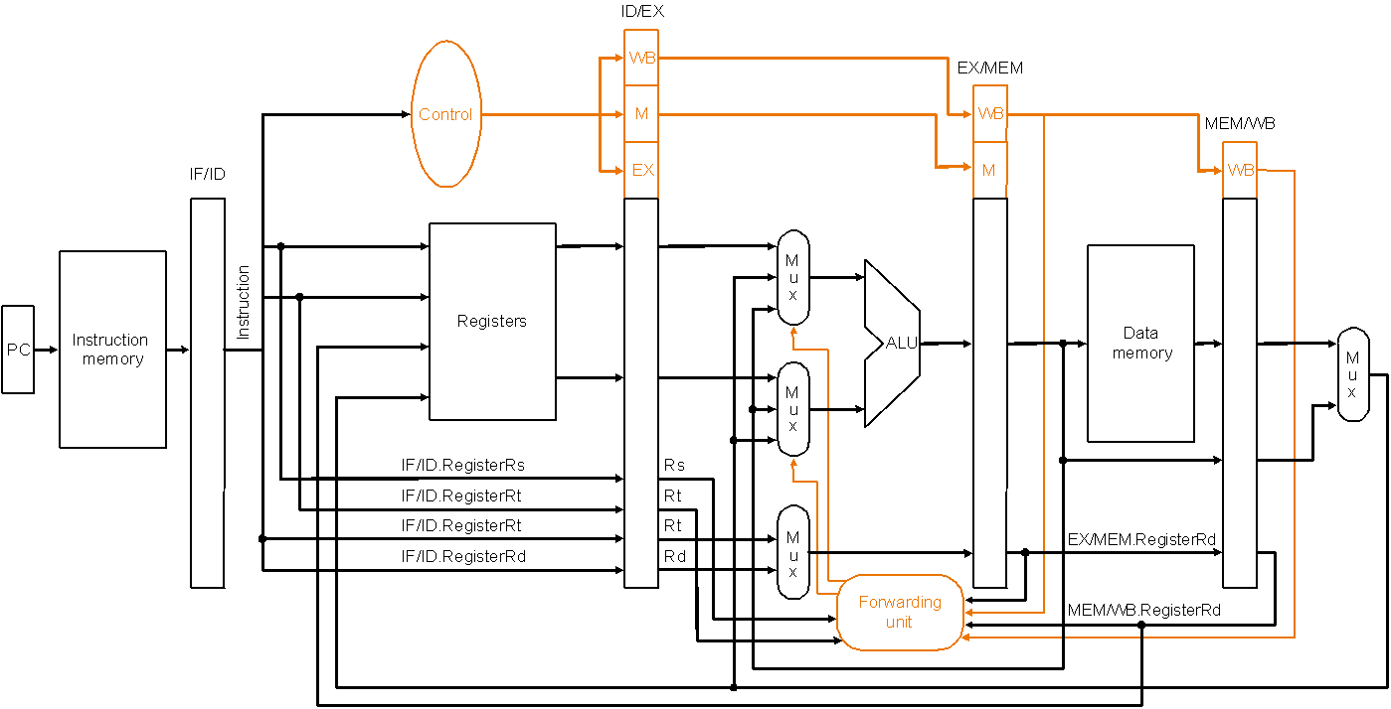
Forwarding Hardware with Control
Called forwarding unit, not hazard detection unit,
because once data is forwarded there is no hazard!
Datapath with forwarding hardware and control wires – certain details,
e.g., branching hardware, are omitted to simplify the drawing
Note: so far we have only handled forwarding to R-type instructions…!
Notes:
‹#›

Slide 58
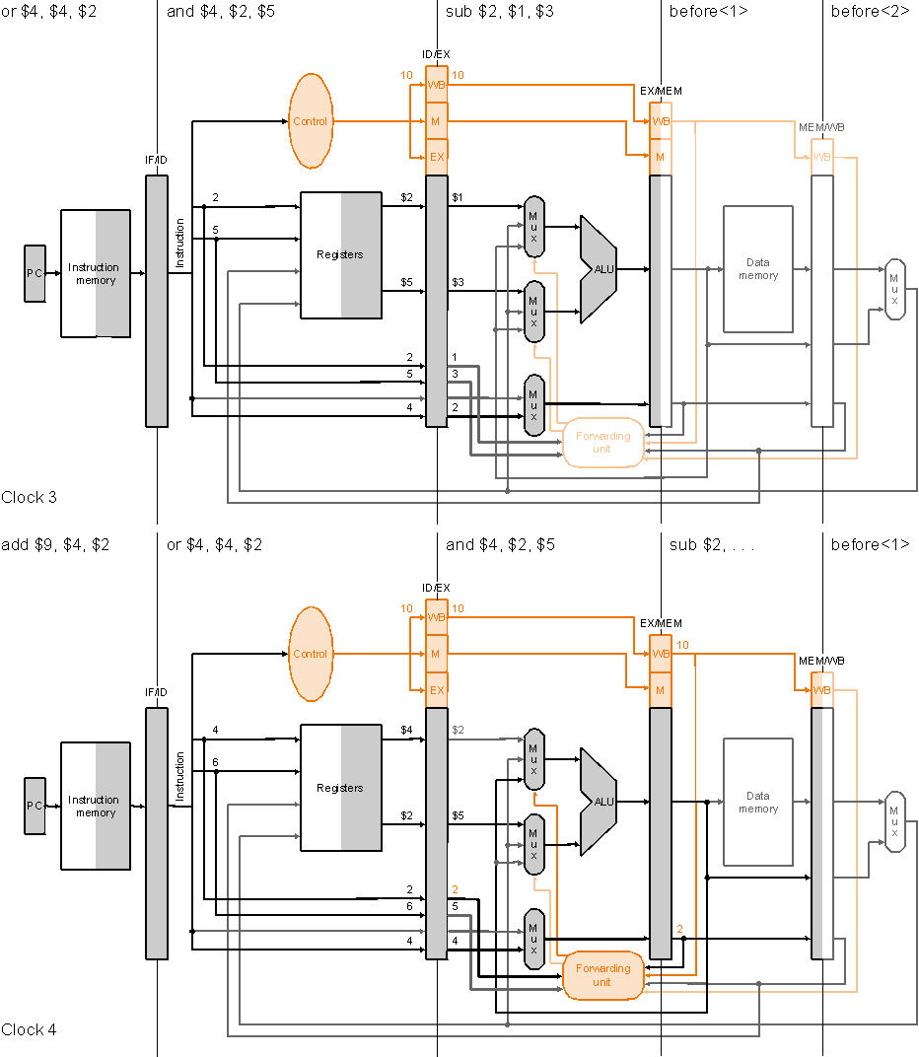
Forwarding
Clock cycle 3
Execution
example:
sub $2, $1, $3
and $4, $2, $5
or $4, $4, $2
add $9, $4, $2
Clock cycle 4

Slide 59
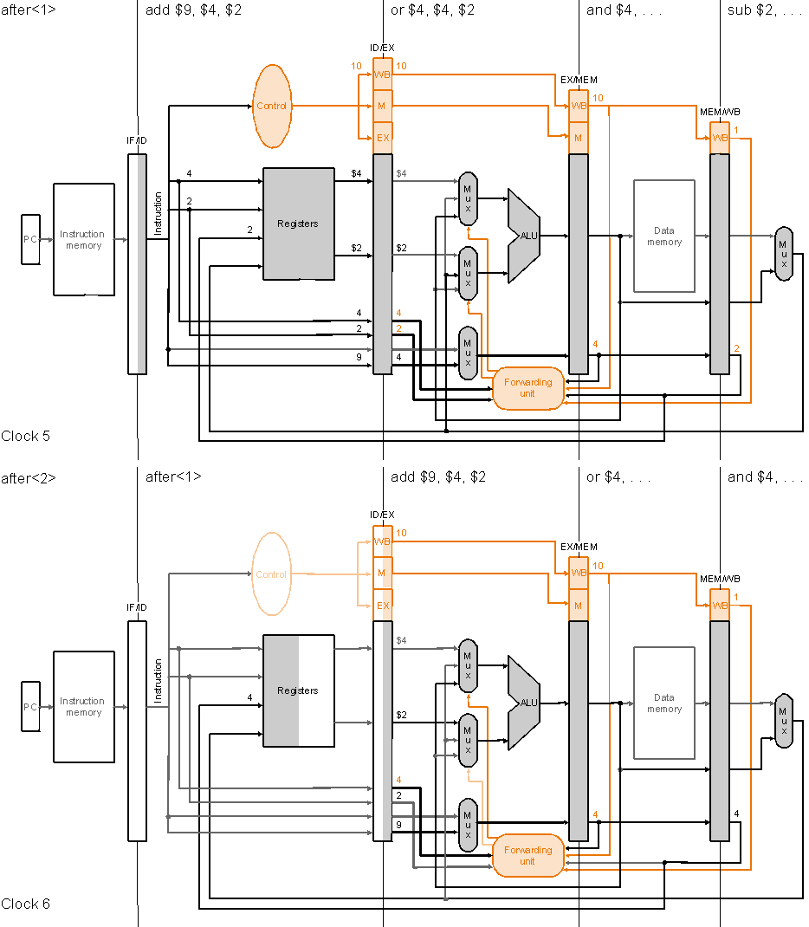
Forwarding
Execution
example
(cont.):
Clock cycle 5
sub $2, $1, $3
and $4, $2, $5
or $4, $4, $2
add $9, $4, $2
Clock cycle 6

Slide 60
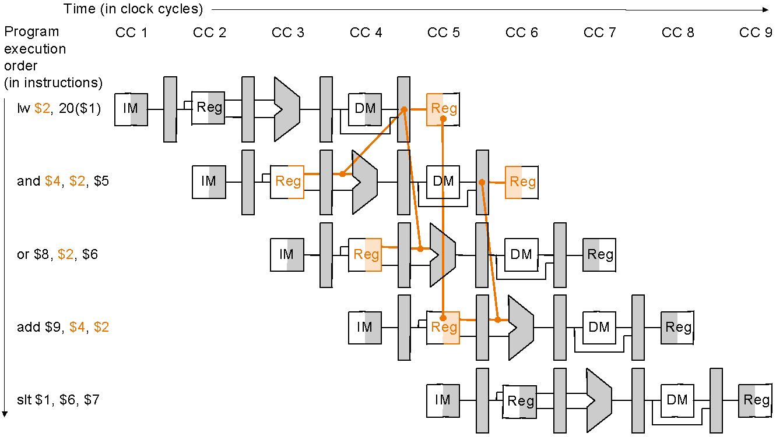
Data Hazards and Stalls
Load word can still cause a hazard:
an instruction tries to read a register following a load instruction that writes to the same register
therefore, we need a hazard detection unit to stall the pipeline after the load instruction
lw $2, 20($1)
and $4, $2, $5
or $8, $2, $6
add $9, $4, $2
Slt $1, $6, $7
As even a pipeline
dependency goes
backward in time
forwarding will not
solve the hazard
Notes:
‹#›

Slide 61
Pipelined Datapath with Control II (as before)
Control signals
emanate from
the control
portions of the
pipeline registers
Notes:
‹#›

Slide 62
Hazard Detection Logic to Stall
Hazard detection unit implements the following check if to stall
if ( ID/EX.MemRead // if the instruction in the EX stage is a load…
and ( ( ID/EX.RegisterRt = IF/ID.RegisterRs ) // and the destination register
or ( ID/EX.RegisterRt = IF/ID.RegisterRt ) ) ) // matches either source register
// of the instruction in the ID stage, then…
stall the pipeline

Slide 63
Mechanics of Stalling
If the check to stall verifies, then the pipeline needs to stall only 1 clock cycle after the load as after that the forwarding unit can resolve the dependency
What the hardware does to stall the pipeline 1 cycle:
does not let the IF/ID register change (disable write!) – this will cause the instruction in the ID stage to repeat, i.e., stall
therefore, the instruction, just behind, in the IF stage must be stalled as well – so hardware does not let the PC change (disable write!) – this will cause the instruction in the IF stage to repeat, i.e., stall
changes all the EX, MEM and WB control fields in the ID/EX pipeline register to 0, so effectively the instruction just behind the load becomes a nop – a bubble is said to have been inserted into the pipeline
note that we cannot turn that instruction into an nop by 0ing all the bits in the instruction itself – recall nop = 00…0 (32 bits) – because it has already been decoded and control signals generated

Slide 64
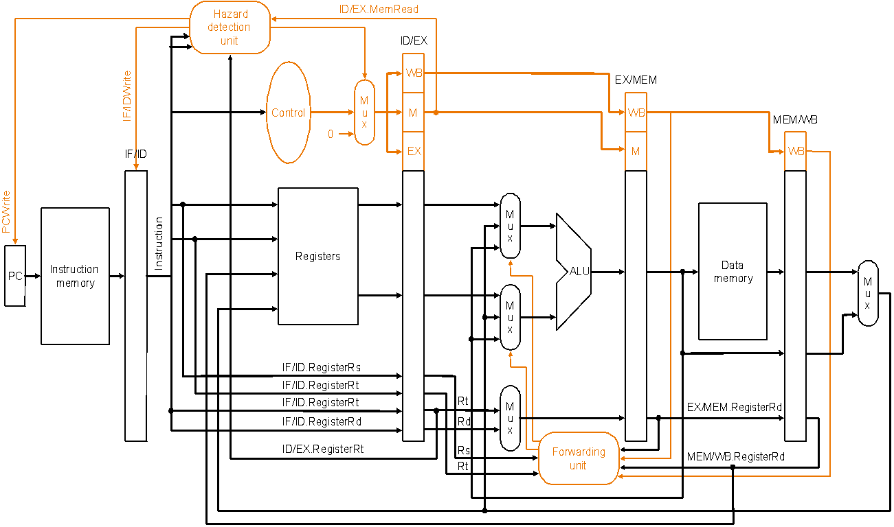
Hazard Detection Unit
Datapath with forwarding hardware, the hazard detection unit and
controls wires – certain details, e.g., branching hardware are omitted
to simplify the drawing
Notes:
‹#›

Slide 65
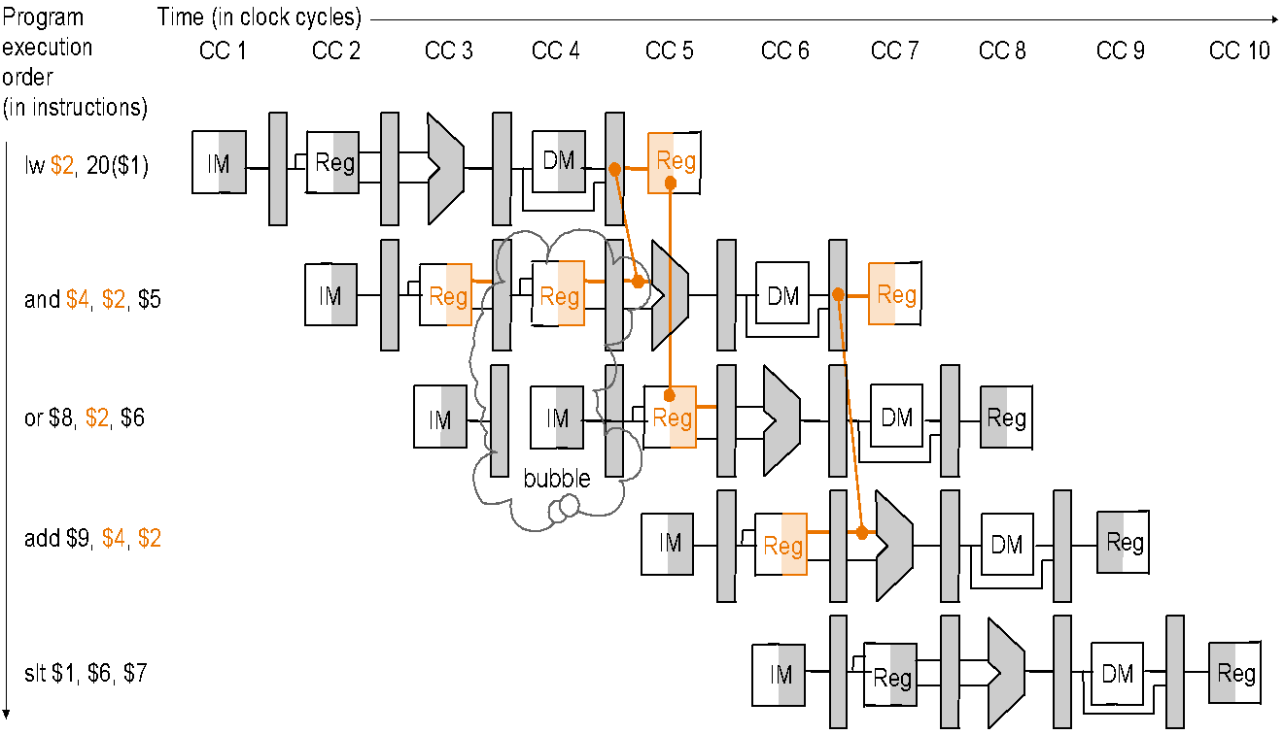
Stalling Resolves a Hazard
Same instruction sequence as before for which forwarding by itself could not resolve the hazard:
lw $2, 20($1)
and $4, $2, $5
or $8, $2, $6
add $9, $4, $2
Slt $1, $6, $7
Hazard detection unit inserts a 1-cycle bubble in the pipeline, after
which all pipeline register dependencies go forward so then the
forwarding unit can handle them and there are no more hazards
Notes:
‹#›

Slide 66
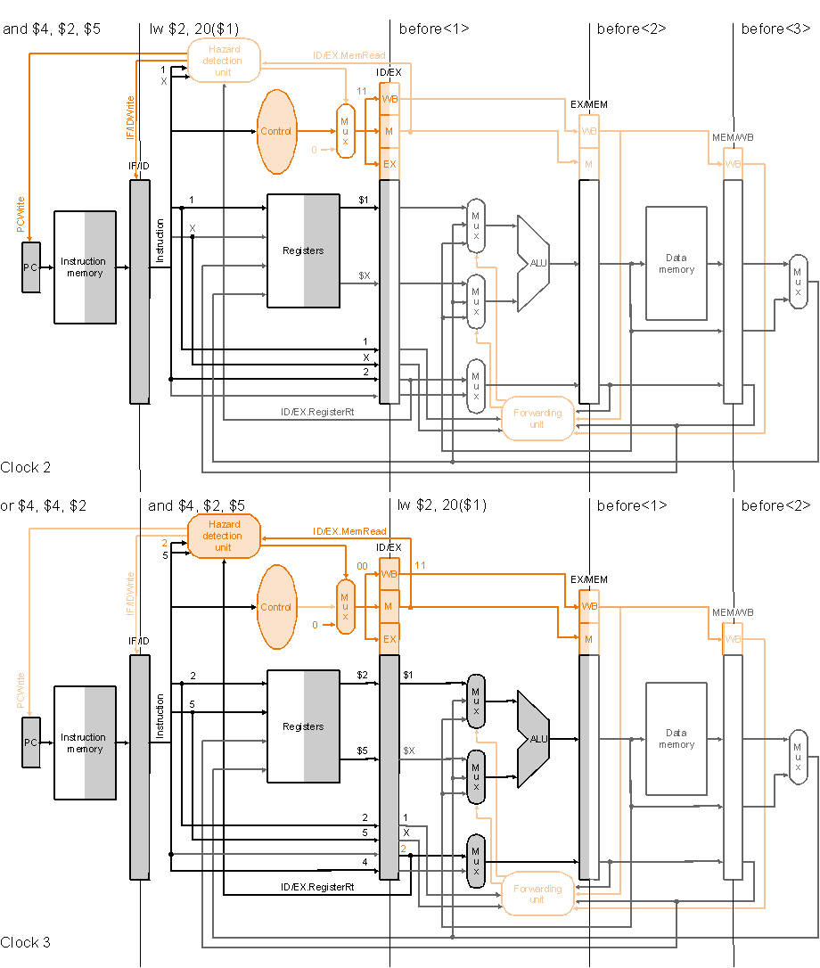
Stalling
Execution
example:
Clock cycle 2
lw $2, 20($1)
and $4, $2, $5
or $4, $4, $2
add $9, $4, $2
Clock cycle 3

Slide 67
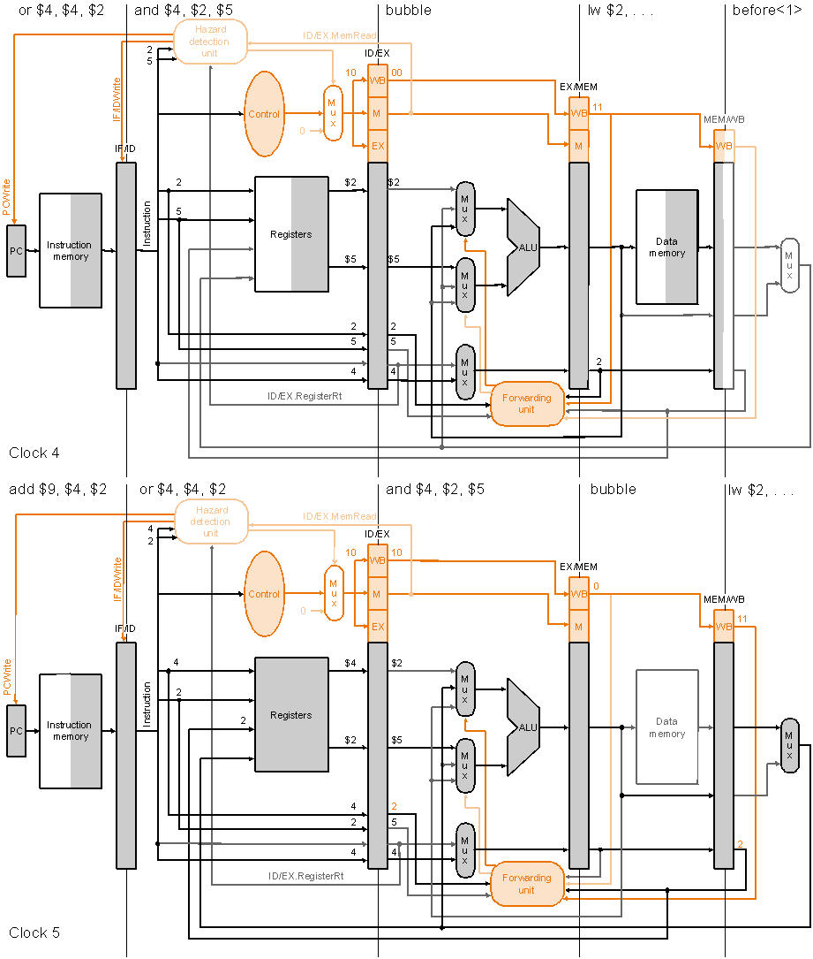
Stalling
Execution
example
(cont.):
Clock cycle 4
lw $2, 20($1)
and $4, $2, $5
or $4, $4, $2
add $9, $4, $2
Clock cycle 5

Slide 68
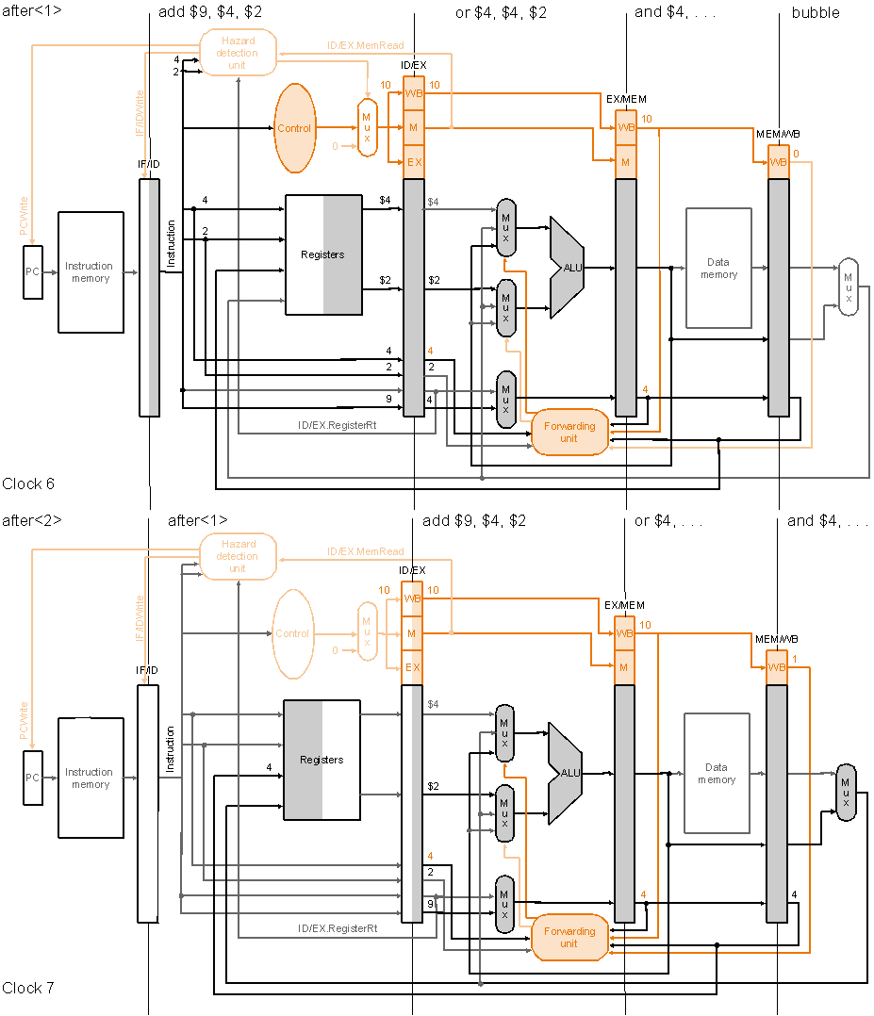
Stalling
Execution
example
(cont.):
Clock cycle 6
lw $2, 20($1)
and $4, $2, $5
or $4, $4, $2
add $9, $4, $2
Clock cycle 7

Slide 69
Control (or Branch) Hazards
Problem with branches in the pipeline we have so far is that the branch decision is not made till the MEM stage – so what instructions, if at all, should we insert into the pipeline following the branch instructions?
Possible solution: stall the pipeline till branch decision is known
not efficient, slow the pipeline significantly!
Another solution: predict the branch outcome
e.g., always predict branch-not-taken – continue with next sequential instructions
if the prediction is wrong have to flush the pipeline behind the branch – discard instructions already fetched or decoded – and continue execution at the branch target
Notes:
‹#›

Slide 70
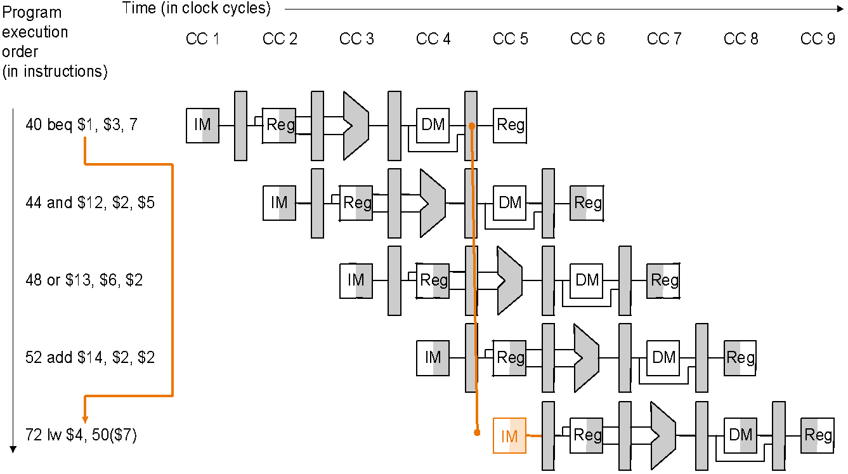
Predicting Branch-not-taken: Misprediction delay
The outcome of branch taken (prediction wrong) is decided only when
beq is in the MEM stage, so the following three sequential instructions
already in the pipeline have to be flushed and execution resumes at lw

Slide 71
Optimizing the Pipeline to Reduce Branch Delay
Move the branch decision from the MEM stage (as in our current pipeline) earlier to the ID stage
calculating the branch target address involves moving the branch adder from the MEM stage to the ID stage – inputs to this adder, the PC value and the immediate fields are already available in the IF/ID pipeline register
calculating the branch decision is efficiently done, e.g., for equality test, by XORing respective bits and then ORing all the results and inverting, rather than using the ALU to subtract and then test for zero (when there is a carry delay)
with the more efficient equality test we can put it in the ID stage without significantly lengthening this stage – remember an objective of pipeline design is to keep pipeline stages balanced
we must correspondingly make additions to the forwarding and hazard detection units to forward to or stall the branch at the ID stage in case the branch decision depends on an earlier result

Slide 72
Flushing on Misprediction
Same strategy as for stalling on load-use data hazard…
Zero out all the control values (or the instruction itself) in pipeline registers for the instructions following the branch that are already in the pipeline – effectively turning them into nops – so they are flushed
in the optimized pipeline, with branch decision made in the ID stage, we have to flush only one instruction in the IF stage – the branch delay penalty is then only one clock cycle

Slide 73
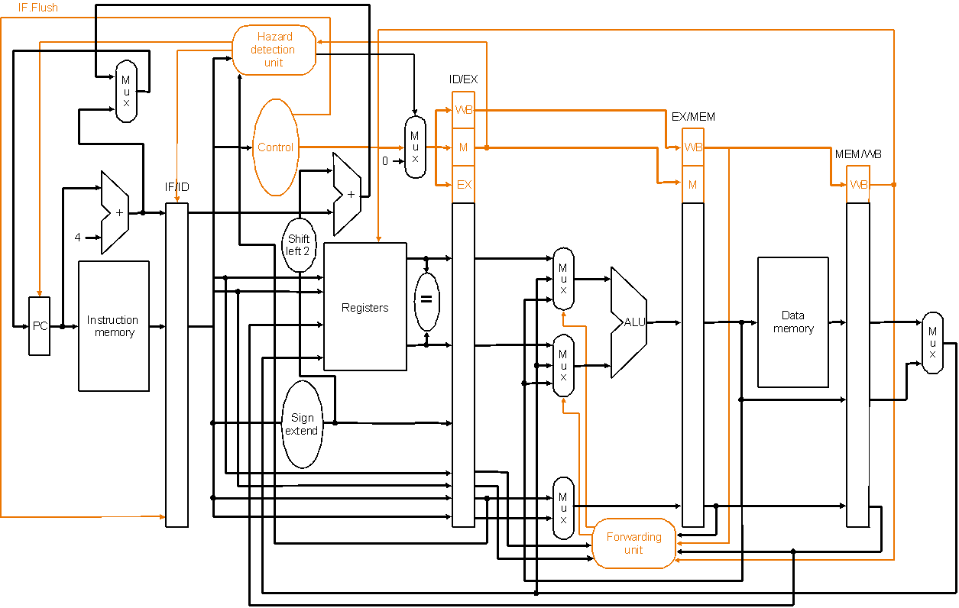
Optimized Datapath for Branch
IF.Flush control zeros out the instruction in the IF/ID
pipeline register (which follows the branch)
Branch decision is moved from the MEM stage to the ID stage – simplified drawing not showing enhancements to the forwarding and hazard detection units

Slide 74
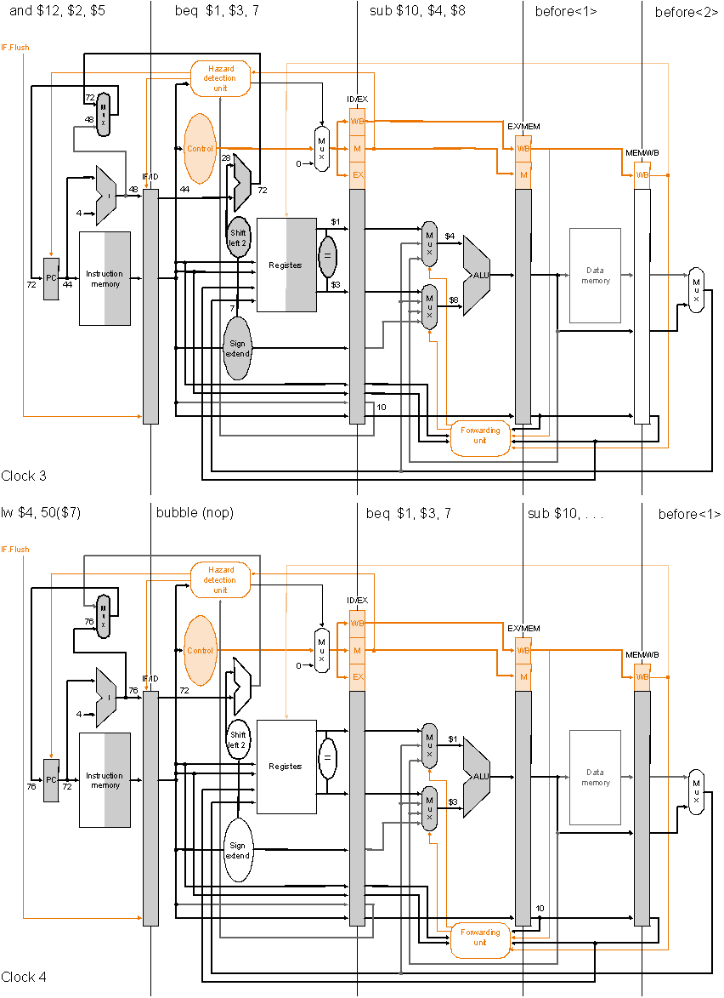
Pipelined Branch
Execution
example:
Clock cycle 3
36 sub $10, $4, $8
40 beq $1, $3, 7
44 and $12 $2, $5
48 or $13 $2, $6
52 add $14, $4, $2
56 slt $15, $6, $7
…
72 lw $4, 50($7)
Optimized pipeline with
only one bubble as a result
of the taken branch
Clock cycle 4

Slide 75
Simple Example: Comparing Performance
Compare performance for single-cycle, multicycle, and pipelined datapaths using the gcc instruction mix
assume 2 ns for memory access, 2 ns for ALU operation, 1 ns for register read or write
assume gcc instruction mix 23% loads, 13% stores, 19% branches, 2% jumps, 43% ALU
for pipelined execution assume
50% of the loads are followed immediately by an instruction that uses the result of the load
25% of branches are mispredicted
branch delay on misprediction is 1 clock cycle
jumps always incur 1 clock cycle delay so their average time is 2 clock cycles

Slide 76
Simple Example: Comparing Performance
Single-cycle (p. 373): average instruction time 8 ns
Multicycle (p. 397): average instruction time 8.04 ns
Pipelined:
loads use 1 cc (clock cycle) when no load-use dependency and 2 cc when there is dependency – given 50% of loads are followed by dependency the average cc per load is 1.5
stores use 1 cc each
branches use 1 cc when predicted correctly and 2 cc when not – given 25% misprediction average cc per branch is 1.25
jumps use 2 cc each
ALU instructions use 1 cc each
therefore, average CPI is
1.5 × 23% + 1 × 13% + 1.25 × 19% + 2 × 2% + 1 × 43% = 1.18
therefore, average instruction time is 1.18 × 2 = 2.36 ns

